Slide 1
CMOS Technology & CMOS Logic Gates
BY- Chandramouli Haldar

Slide 2
What is CMOS?
CMOS = Complementary Metal Oxide Semiconductor
Uses two types of MOSFETs:
  NMOS (N-type MOS)
  PMOS (P-type MOS)
Called complementary because:
  One transistor turns ON while the other turns OFF.
Widely used in VLSI chip design
Low power consumption
High noise immunity
High packing density

Slide 3
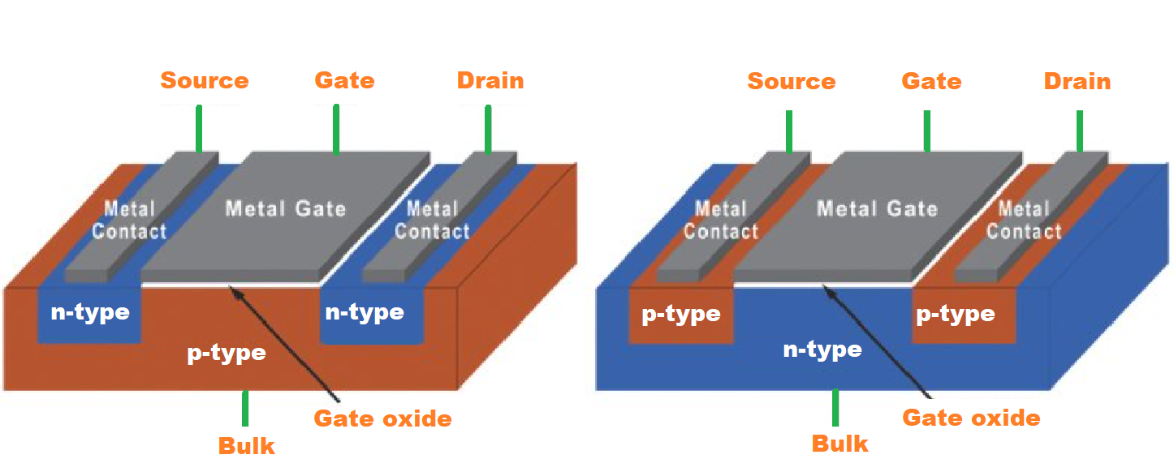
What is MOSFET?
MOSFET = Metal Oxide Semiconductor Field Effect Transistor
It is a voltage-controlled device used to switch and amplify electronic signals.
Basic building block of CMOS technology
Used in all digital ICs
Controls current using electric field

Slide 4
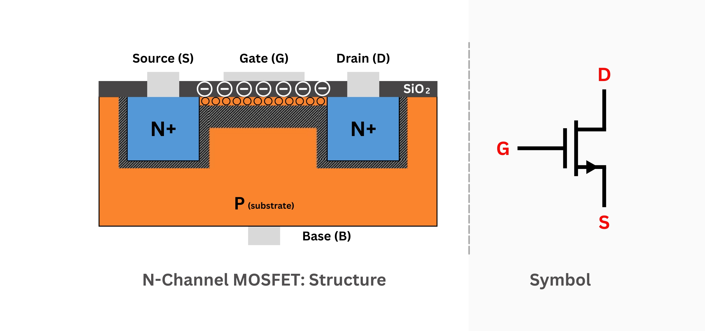
MOSFET
It has Four Terminals:
Gate (G)
Drain (D)
Source (S)
Body (B)
Gate is separated from channel by a thin oxide layer.
When voltage is applied to Gate:
  Electric field forms
  Channel is created between Source and Drain
  Current flows
No direct connection between gate and channel
Very high input impedance

Slide 5
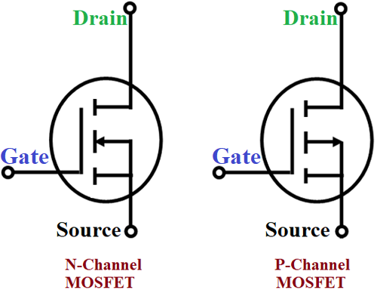
Types of MOSFET

Slide 6
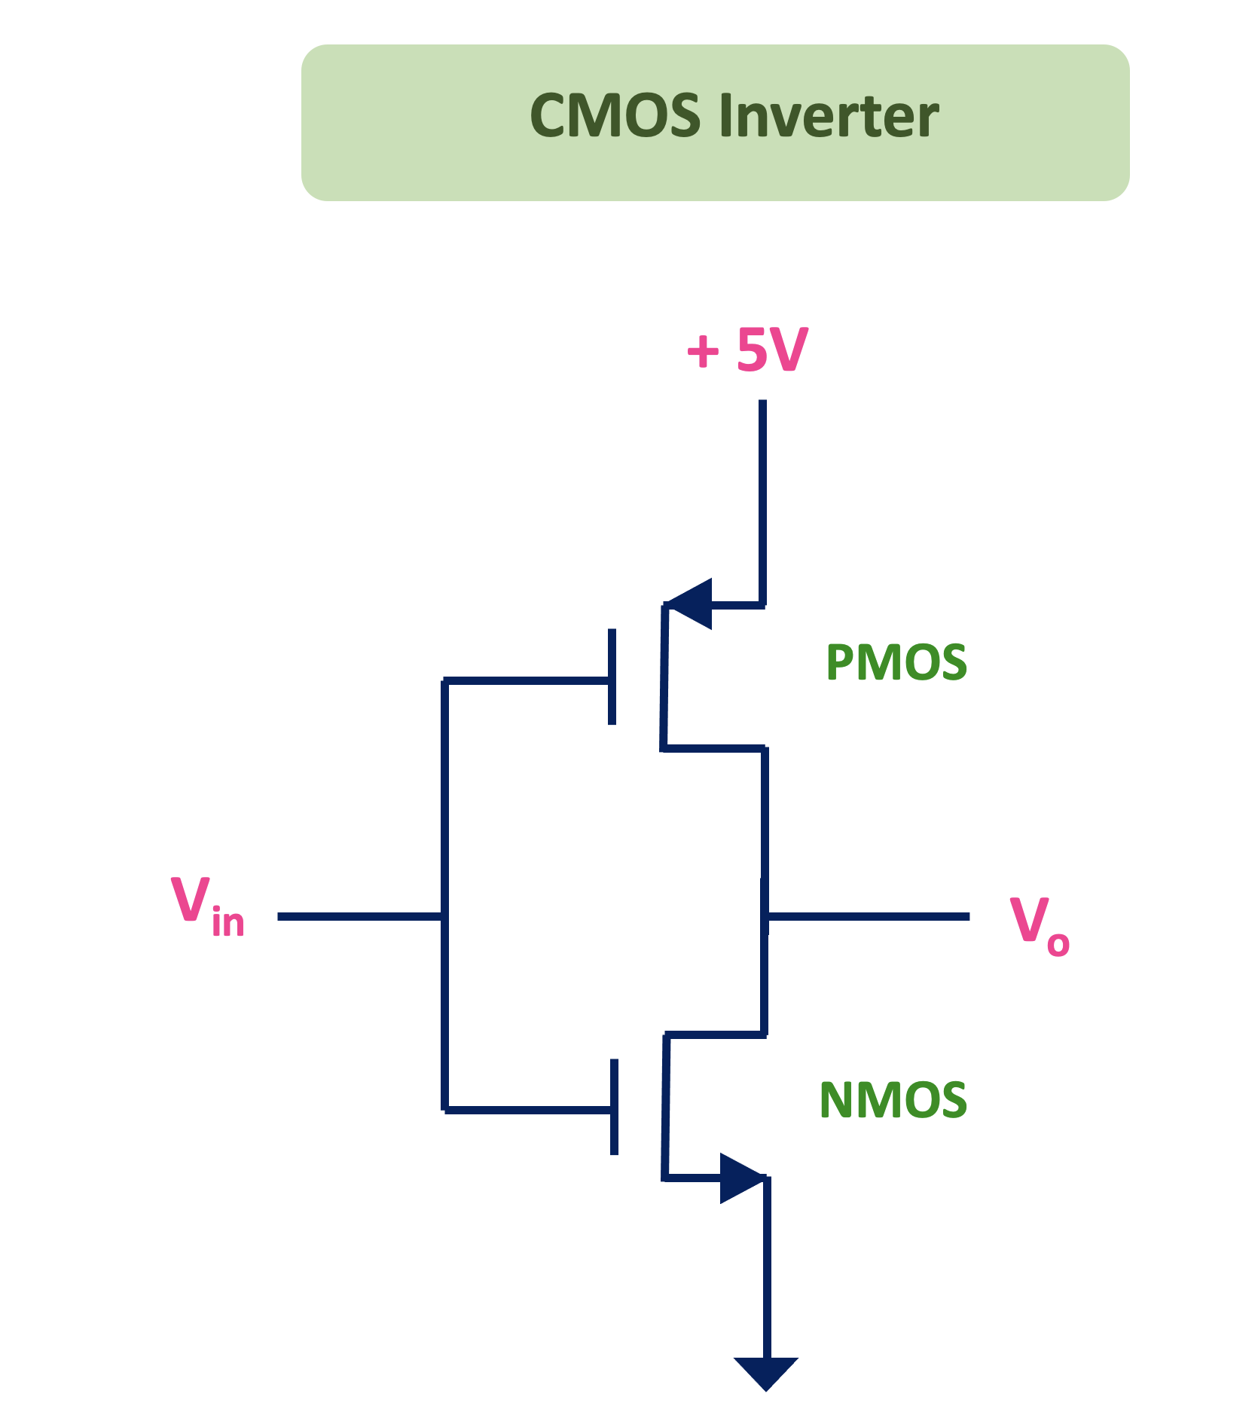
CMOS Inverter
Structure:
1 PMOS (connected to VDD)
1 NMOS (connected to GND)
Input connected to both gates
Output taken from middle
Working:
Case 1: Input = 0
PMOS → ON
NMOS → OFF
Output = 1
Case 2: Input = 1
PMOS → OFF
NMOS → ON
Output = 0
Output is complement of input → INVERTER

Slide 7
CMOS Advantages & Disadvantages
Very low static power consumption
High speed operation
High noise immunity
Full output swing (0 to VDD)
High packing density
Scalable for deep submicron technology
More complex fabrication process
Sensitive to static electricity (ESD)
Latch-up problem possible
Dynamic power increases with frequency

Slide 8
Applications of CMOS
✔ Microprocessors
✔ Memory (RAM, ROM)
✔ ASIC design
✔ FPGA
✔ Mobile processors
✔ IoT devices
✔ Sensors and mixed-signal ICs
Almost all modern digital ICs use CMOS.

Slide 9
CMOS NOT Gate

Slide 10
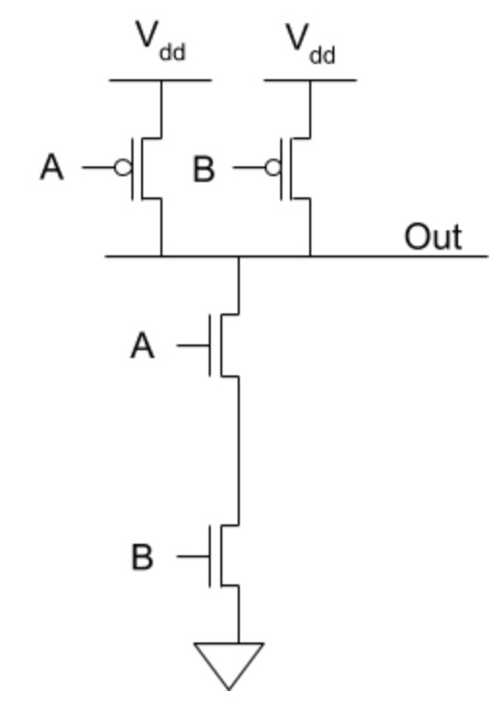
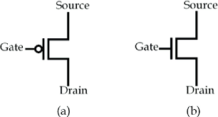
CMOS AND Gate
PMOS transistor and
NMOS transistor.

Slide 11
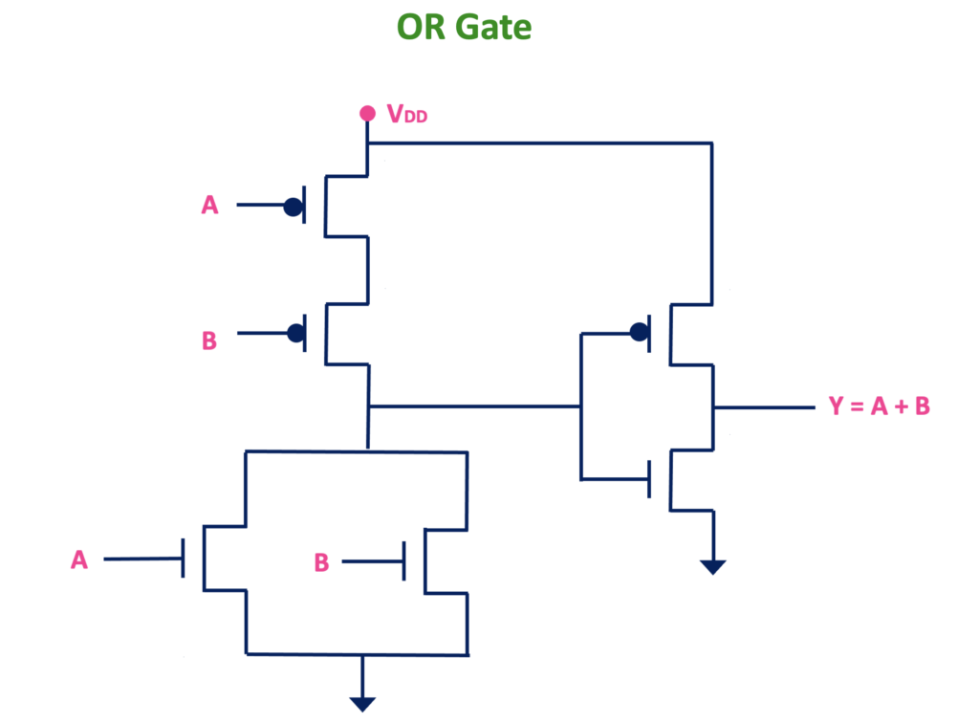
CMOS OR Gate

Slide 12
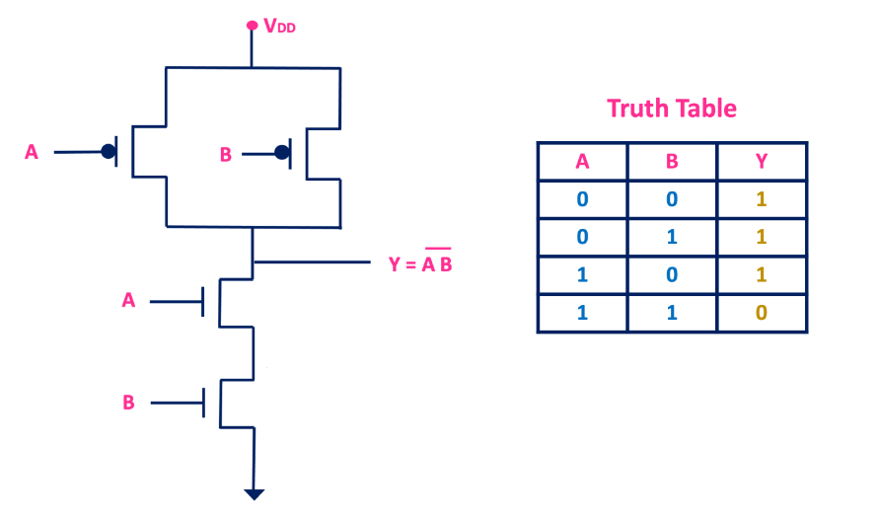
CMOS NAND Gate

Slide 13
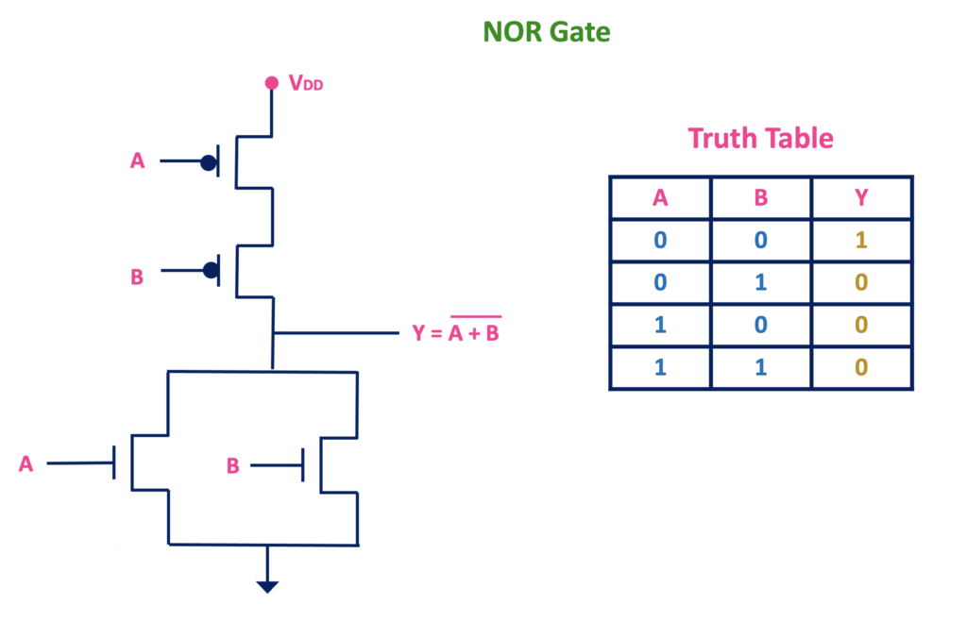
CMOS NOR Gate

Slide 14
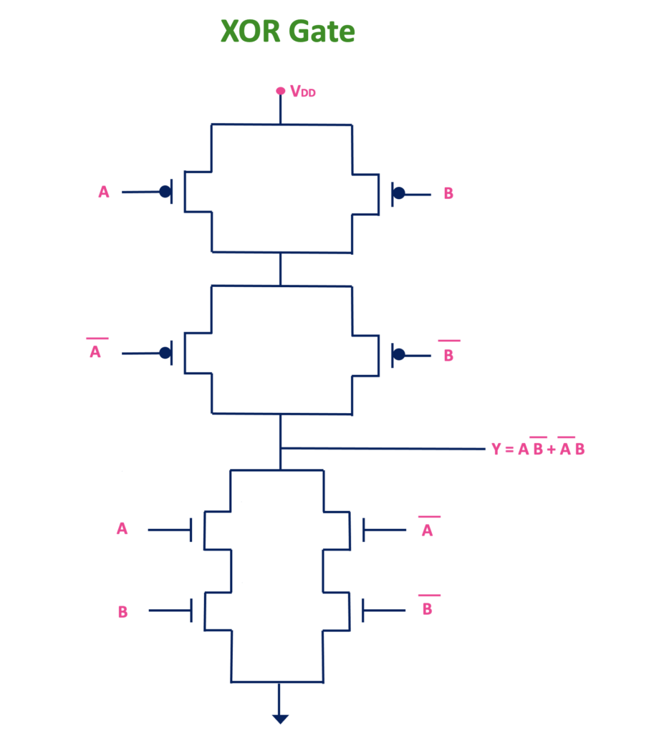
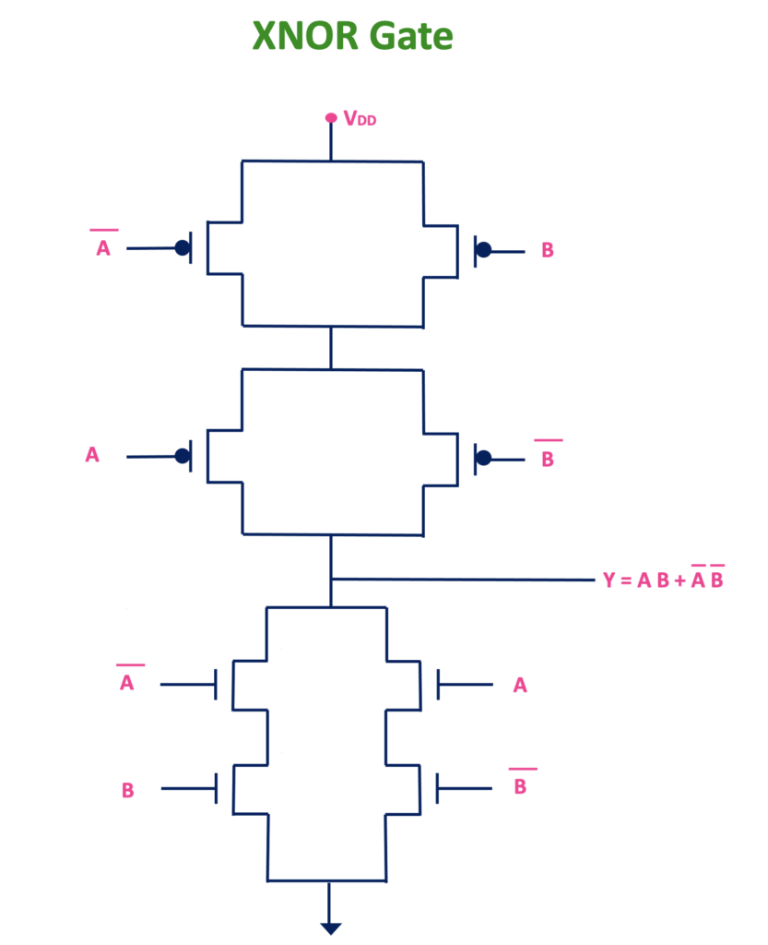

Slide 15
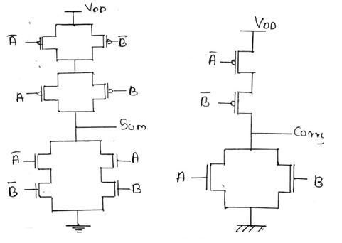
Half Adder

Slide 16
THANK YOU !

